Slide 1
Investigating the Relationship Between Personality Traits and Alcohol Use in a Student Population
By Katie Mahoney

Slide 2
Objective
To investigate psychopathic traits and alcohol use in a student population
The relationship the two sub-types of psychopathy, namely Primary and Secondary psychopathy, have with alcohol use were of particular interest.
The Secondary psychopathy traits were hypothesised to be more strongly related to alcohol use than Primary psychopathy

Slide 3
Psychopathy
Described as form of personality disorder
General population prevalence ~1%, forensic population ~25%
Estimated annual costs ~US$460 billions

Slide 4
Difference between Primary and Secondary
Coined by Levenson et al. (1995) based on the two-factor model posited by Hare et al. (1991) with the Psychopathy Checklist – Revised (PCL-R)
Primary characterised by manipulative, selfish, and callous traits
Secondary characterised by anxious and impulsive traits, involving a range of antisocial behaviours

Slide 5
Alcohol use in a student population
Excessive drinking is a particular problem within a student population
The University experience is associated with consuming extreme quantities of alcohol with relative frequency

Slide 6
Psychopathy and alcohol use
Impulsivity (Secondary psychopathy) is consistently associated with heavy drinking (Sylvers et al., 2011; Smith & Newman, 1990).
Found in a forensic population
Also reported in a student population

Slide 7
Measures
Alcohol Use Disorders Identification Test (AUDIT; Saunders et al., 1993)
- Assesses harmful, and hazardous drinking, and potential alcohol dependence
Levenson’s Self-Report Psychopathy Scale (LSRP; Levenson et al., 1995)
- Assesses psychopathic personality traits

Slide 8
Missing Q3 of AUDIT
Q3 – “How often have you had 6 or more units if female, or 8 or more if male, on a single occasion in the last year?”
Reliability analysis was conducted
Imputation was considered via two methods:
- Imputing the mean
- Utilising Multiple Linear Regression Analysis
Reliability analysis conducted again

Slide 9
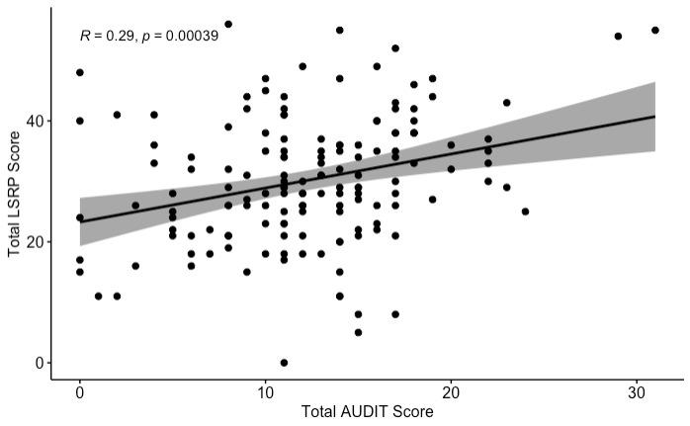
Correlation Scatterplots
Primary Hypothesis

Slide 10
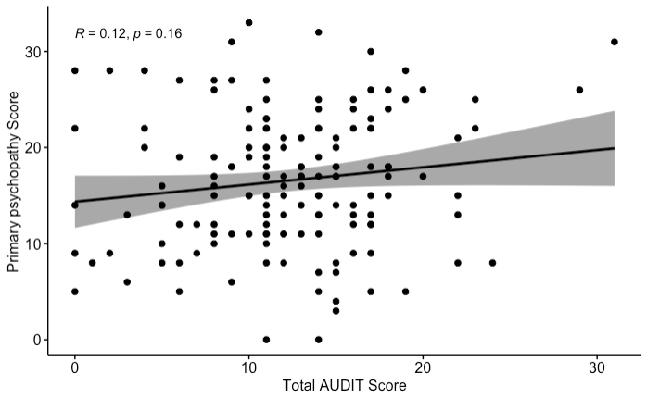
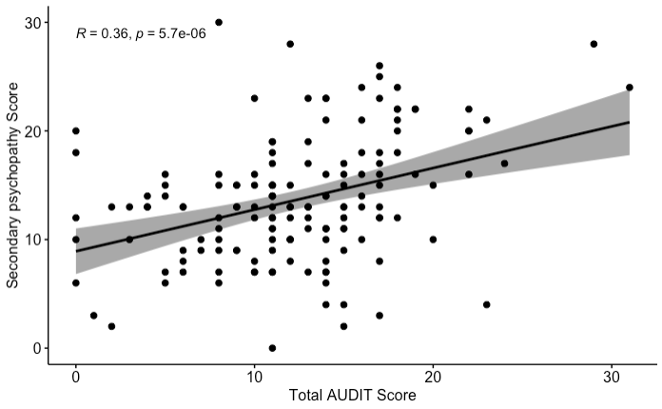
Correlation Scatterplots
Secondary Hypothesis

Slide 11
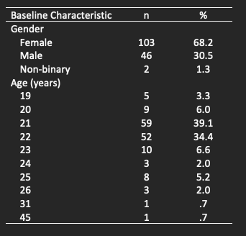
Demographics
Little to no differences found between ages or genders

Slide 12
Clinical Implications
A tool of identification for at-risk students
The LSRP is a suitable tool as it has been validated in a student population (Gummelt et al., 2012), and is accessible online.

Slide 13
Limitations
Self-Report measures
Student (WEIRD) population – limits generalisability
Lack of representation for non-binary

Slide 14
References
Adams, Z. W., Kaiser, A. J., Lynam, D. R., Charnigo, R. J., & Milich, R. (2012). Drinking motives as mediators of the impulsivity-substance use relation: Pathways for negative urgency, lack of premeditation, and sensation seeking. Addictive behaviors, 37(7), 848-855. https://doi.org/10.1016/j.addbeh.2012.03.016
Coid, J., Yang, M., Ullrich, S., Roberts, A., & Hare, R. D. (2009). Prevalence and correlates of psychopathic traits in the household population of Great Britain. International journal of law and psychiatry, 32(2), 65-73. https://doi.org/10.1016/j.ijlp.2009.01.002
Gummelt, H. D., Anestis, J. C., & Carbonell, J. L. (2012). Examining the Levenson Self Report Psychopathy Scale using a graded response model. Personality and Individual Differences, 53(8), 1002-1006. https://doi.org/10.1016/j.paid.2012.07.014
Hare, R. D. (1991). Psychopathy Checklist—Revised [Database record]. APA PsycTests. https://doi.org/10.1037/t01167-000
Hingson, R., Heeren, T., Zakocs, R., Winter, M., & Wechsler, H. (2003). Age of first intoxication, heavy drinking, driving after drinking and risk of unintentional injury among US college students. Journal of studies on alcohol, 64(1), 23-31. https://doi.org/10.15288/jsa.2003.64.23
Kiehl, K. A., & Hoffman, M. B. (2011). The criminal psychopath: History, neuroscience, treatment, and economics. Jurimetrics, 51, 355-397.
Levenson, M. R., Kiehl, K. A., & Fitzpatrick, C. M. (1995). Assessing psychopathic attributes in a noninstitutionalized population. Journal of personality and social psychology, 68(1), 151-158. https://doi.org/10.1037/0022-3514.68.1.151
Lynam, D. R., & Gudonis, L. (2005). The development of psychopathy. Annual Review of Clinical Psychology (2005), 1(1), 381-407. https://doi.org/10.1146/annurev.clinpsy.1.102803.144019

Slide 15
Saunders J. B., Aasland O. G., Babor T. F., de la Fuente J. R., & Grant M. (1993). Development of the Alcohol Use Disorders Identification Test (AUDIT): WHO Collaborative Project on Early Detection of Persons with Harmful Alcohol Consumption II. Addiction, 88(6),791-804. https://doi.org/10.1111/j.1360-0443.1993.tb02093.x
Smith, S. S., & Newman, J. P. (1990). Alcohol and drug abuse-dependence disorders in psychopathic and nonpsychopathic criminal offenders. Journal of abnormal psychology, 99(4), 430-439. https://doi.org/10.1037/0021-843X.99.4.430
Sylvers, P., Landfield, K. E., & Lilienfeld, S. O. (2011). Heavy episodic drinking in college students: Associations with features of psychopathy and antisocial personality disorder. Journal of American college health, 59(5), 367-372. https://doi.org/10.1080/07448481.2010.511363

